Slide 1
breaking blocks
using searching algorithms in ai

Slide 2


Team members
Mohamed Badawy Sayed
Mostafa Ahmed Hasan El-Gelany

Slide 3
Problem Definition
Breaking Blocks is a puzzle game where the goal is to clear a grid by destroying interconnected squares of the same color. The challenge lies in finding an optimal path to eliminate all connected squares strategically, considering their top, right, left, and bottom links. Success in the game depends on identifying a solution path that efficiently clears the board while adhering to the color-matching criteria.

Slide 4
Agent Specification ( PEAS )
Performance Measure | - the number of squares cleared in a given time. - the time taken to complete the level and space
Environment | - a grid of colored squares linked in a top, right, left, and bottom manner. - The state of the environment changes as the agent makes moves to destroy interconnected squares
Actuators | - select and destroy squares in the grid.
Sensors | - the colors of the squares and their connectivity -Look at the last row to see if it is complete or not

Slide 5
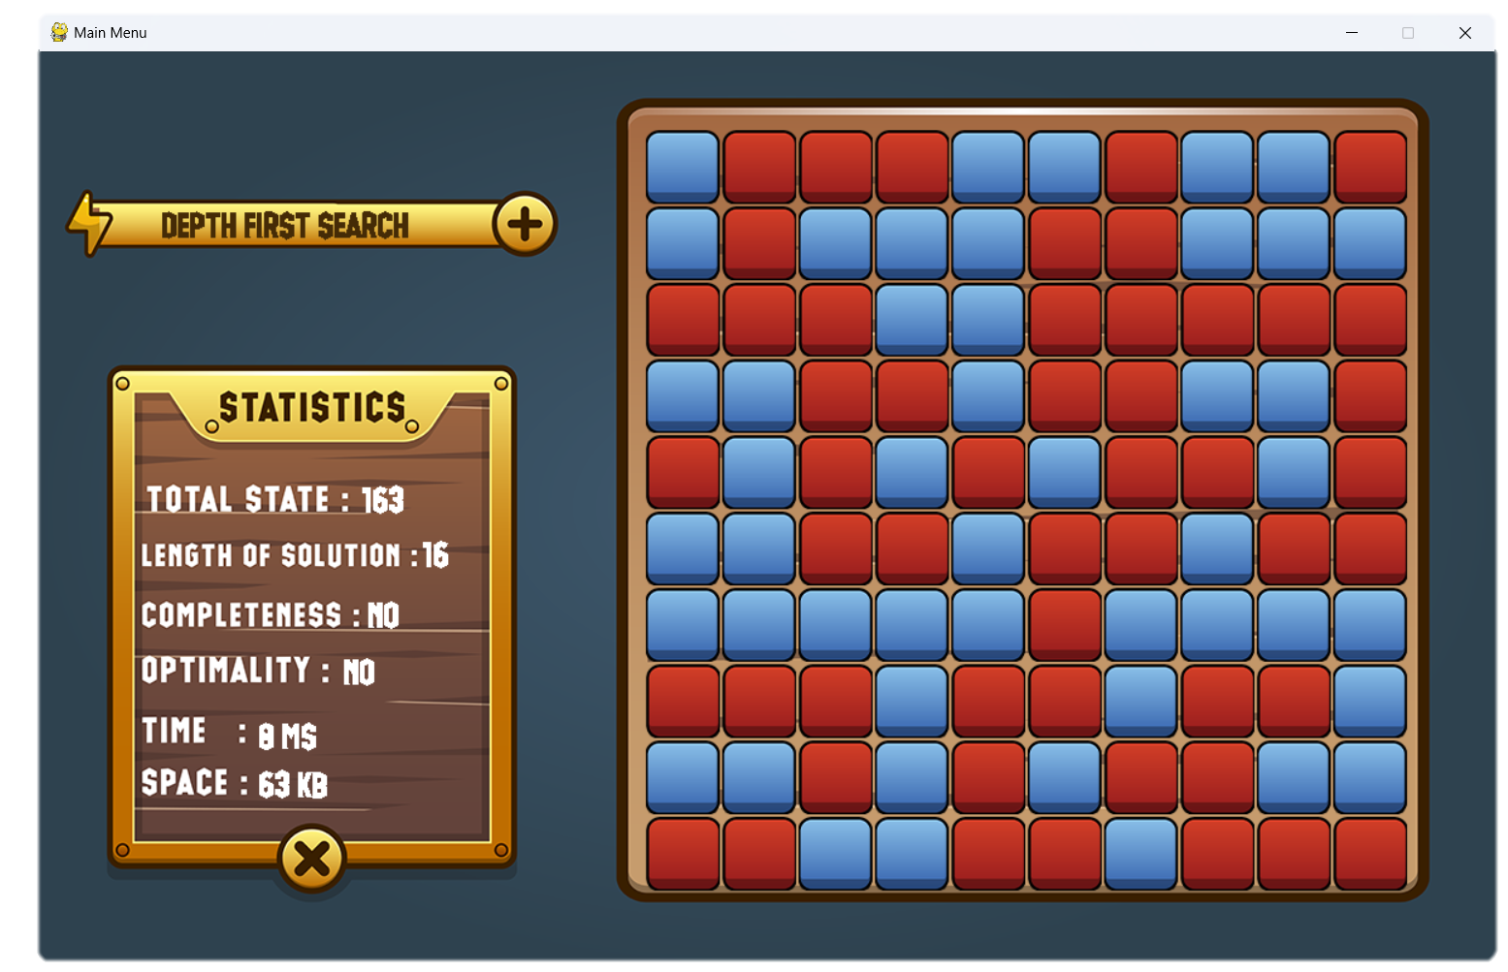
Problem Formulation
Start State : The initial configuration of the game grid, where interconnected squares of various colors exist

Slide 6

Problem Formulation
Goal Space : The goal state is reached when all interconnected squares of the same color are eliminated, resulting in a cleared grid

Slide 7
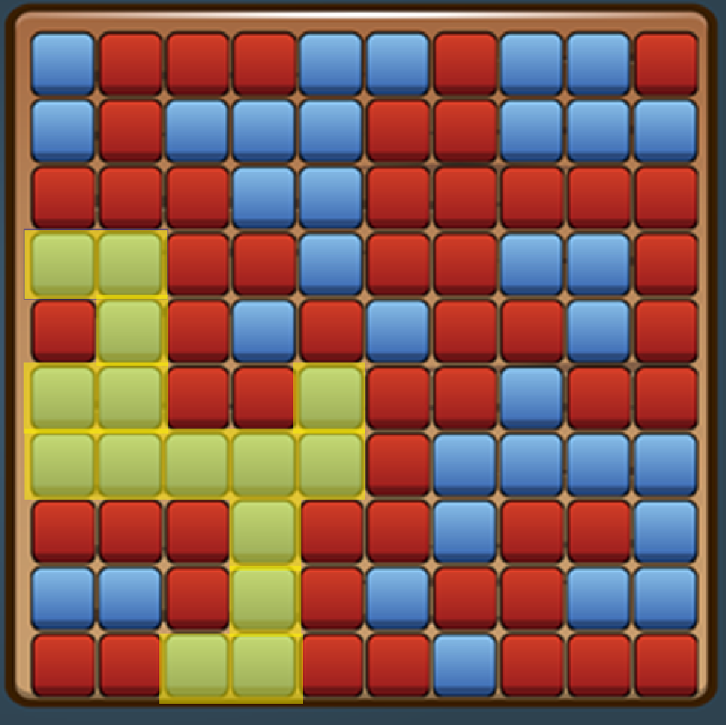
Problem Formulation
Actions :
Select a square to destroy.
Trigger a chain reaction by eliminating a square, causing interconnected squares of the same color to be destroyed.

Slide 8
Problem Formulation
State Space :
The state space encompasses all possible configurations of the Breaking Blocks game grid that can be reached through legal moves

Slide 9
Problem Formulation
Path Cost : Total number of explosions taken to reach the target state

Slide 10
Problem Formulation
Task Environment :
Fully Observable: States are entirely observable as the complete configuration of interconnected squares on the game grid is visible to the agent through sensors.
Deterministic: The environment is deterministic because the next state can be entirely determined by the current state and the agent's actions. There are no random or unpredictable elements in the transitions between states.
Sequential: The environment is sequential as the current decision made by the agent influences future decisions. Actions taken at one

Slide 11
Problem Formulation
Task Environment :
Static: The environment is static because the Breaking Blocks game doesn't introduce external changes or unpredictable events. The agent is only concerned with the current state and doesn't need to consider dynamic elements beyond its control.
Discrete: The environment is discrete since there is a limited and defined number of distinct, clearly defined states. The game grid consists of a finite number of interconnected squares, and the agent's actions result in discrete changes to the configuration.
Single Agent: There is only one agent involved in the Breaking Blocks game. The actions and decisions of this solitary agent determine the progression of the game, and there is no interaction with other agents.

Slide 12
Algorithms
DFS
BFS
Depth Limit Search
Iterative depth limit
Greedy Best First
Uniform cost search
A star

Slide 13
Total State Comparison

Slide 14
Path Comparison

Slide 15
Space comparezon

Slide 16
Time Comparison

Slide 17
Total Comparison

Slide 18
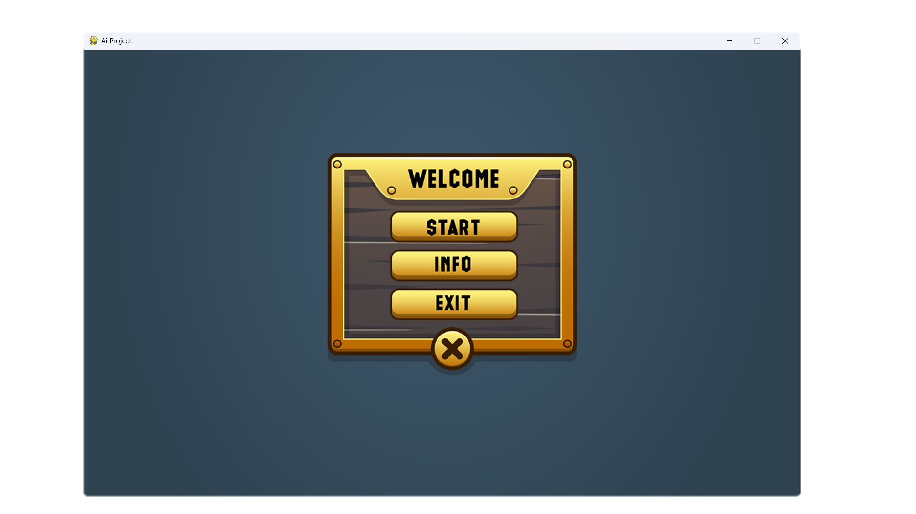
Screenshots

Slide 19
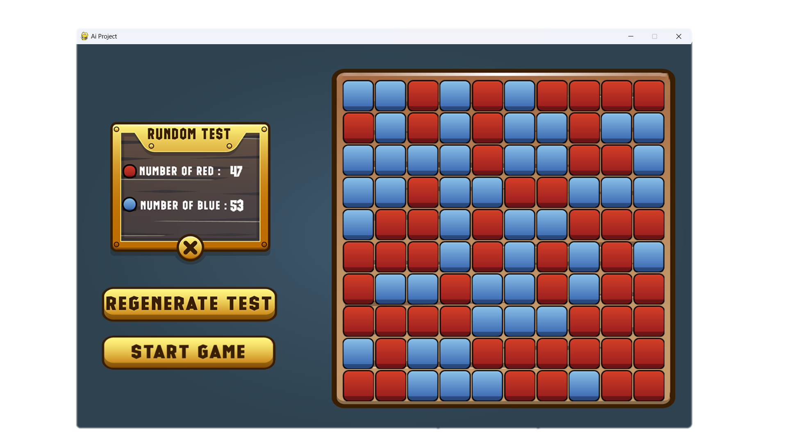
Screenshots

Slide 20
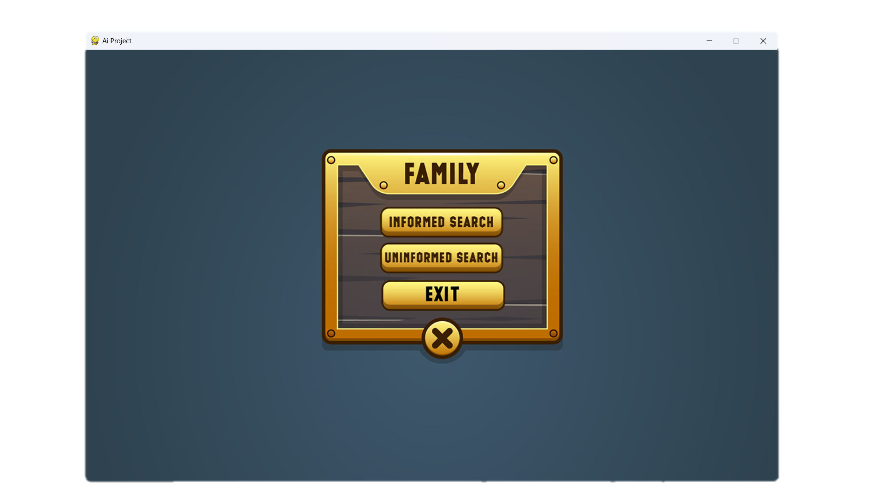
Screenshots

Slide 21
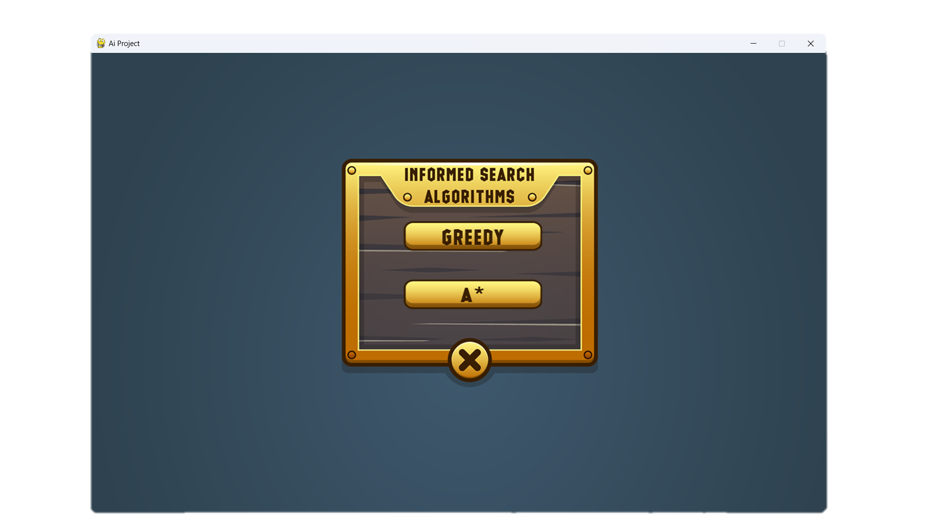
Screenshots

Slide 22
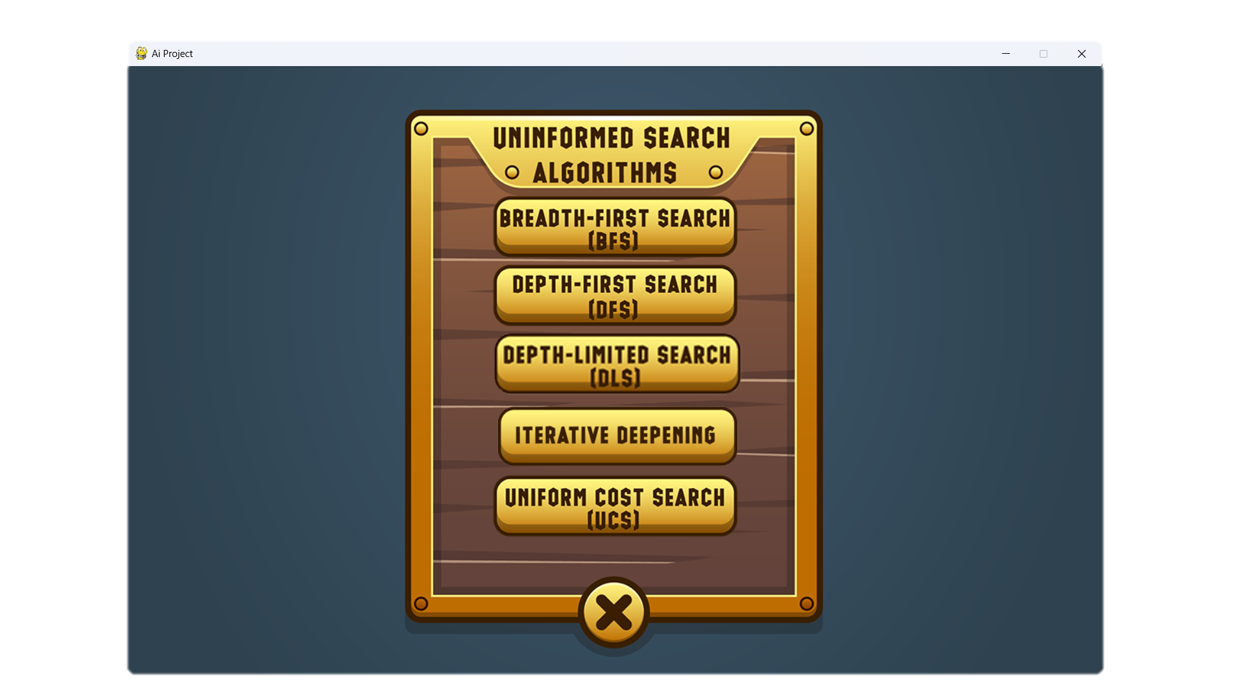
Screenshots

Slide 23
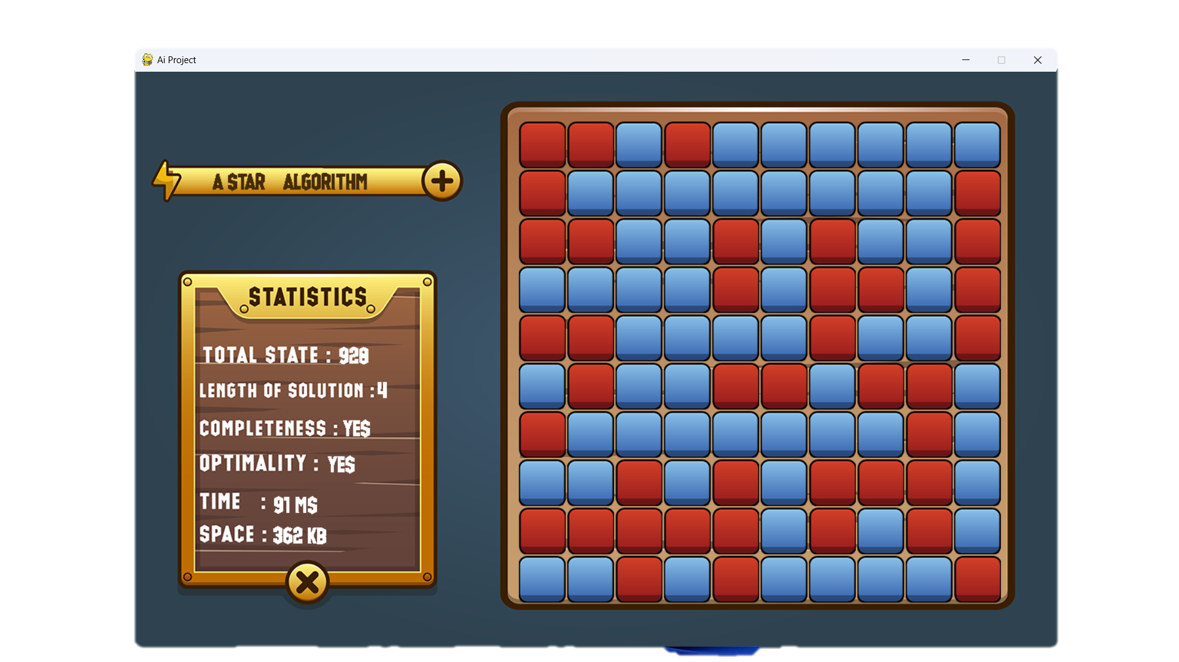
Screenshots

Slide 24
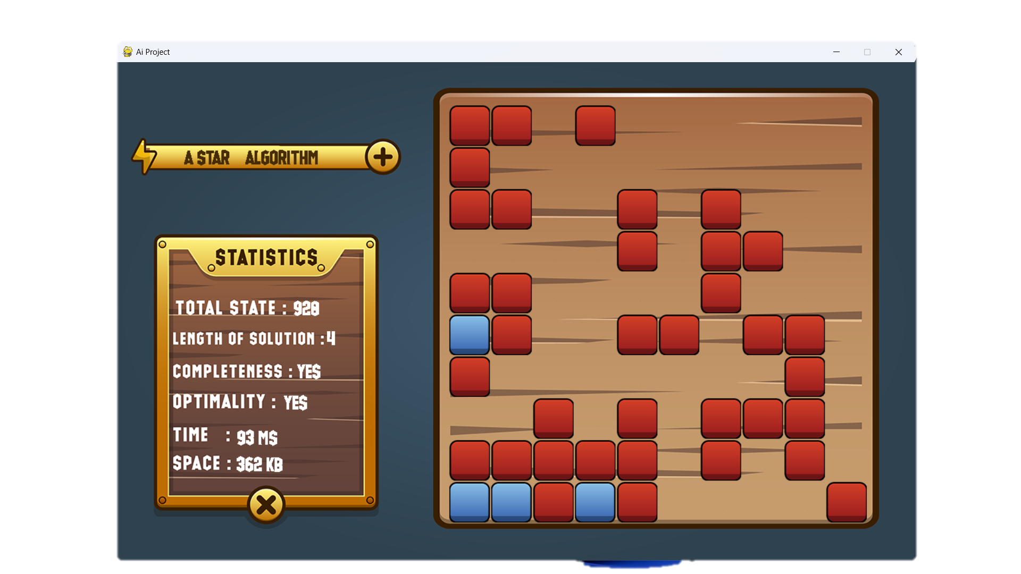
Screenshots

Slide 25
Thank You

